Slide 1





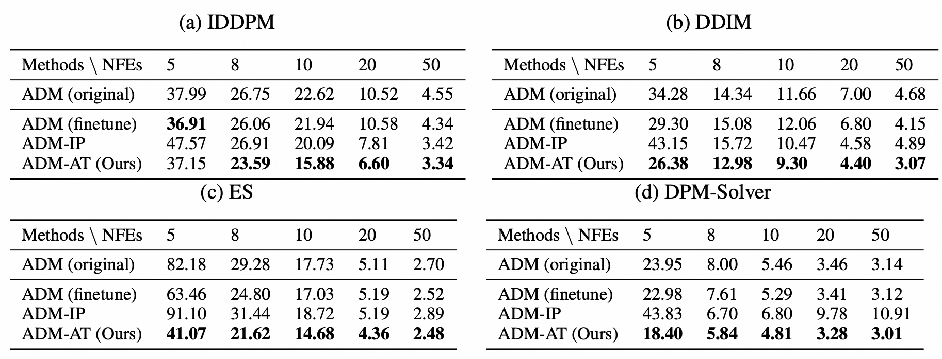
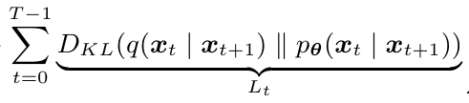

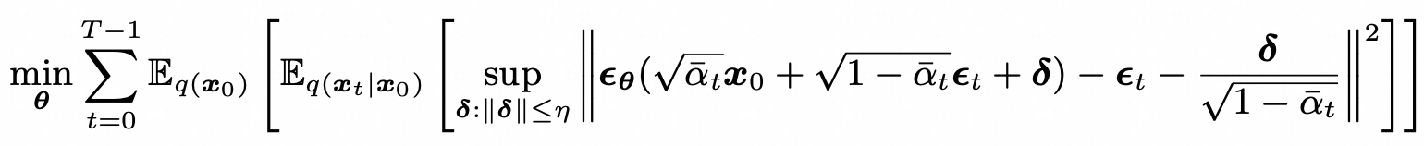
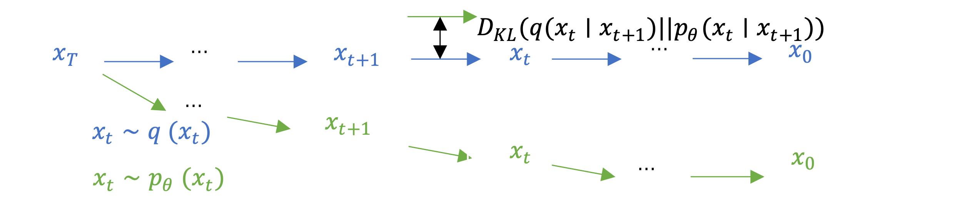
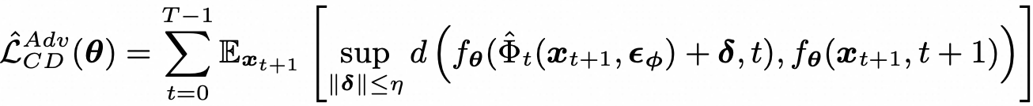
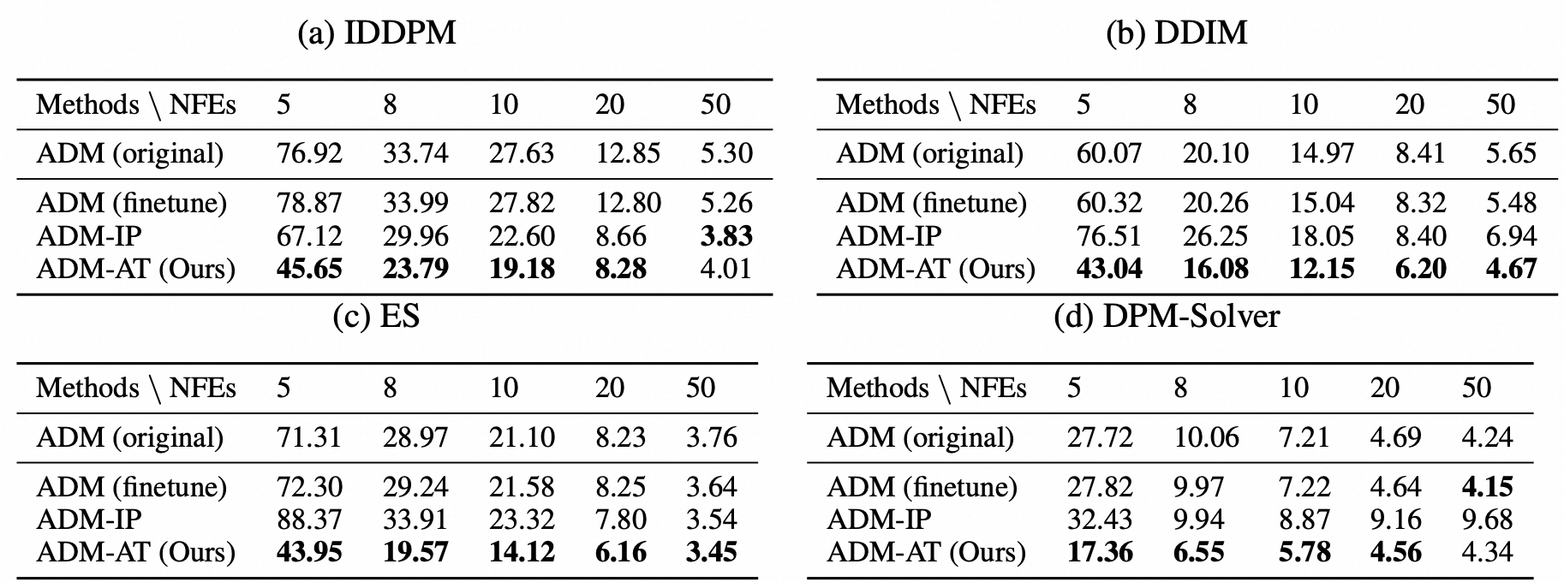
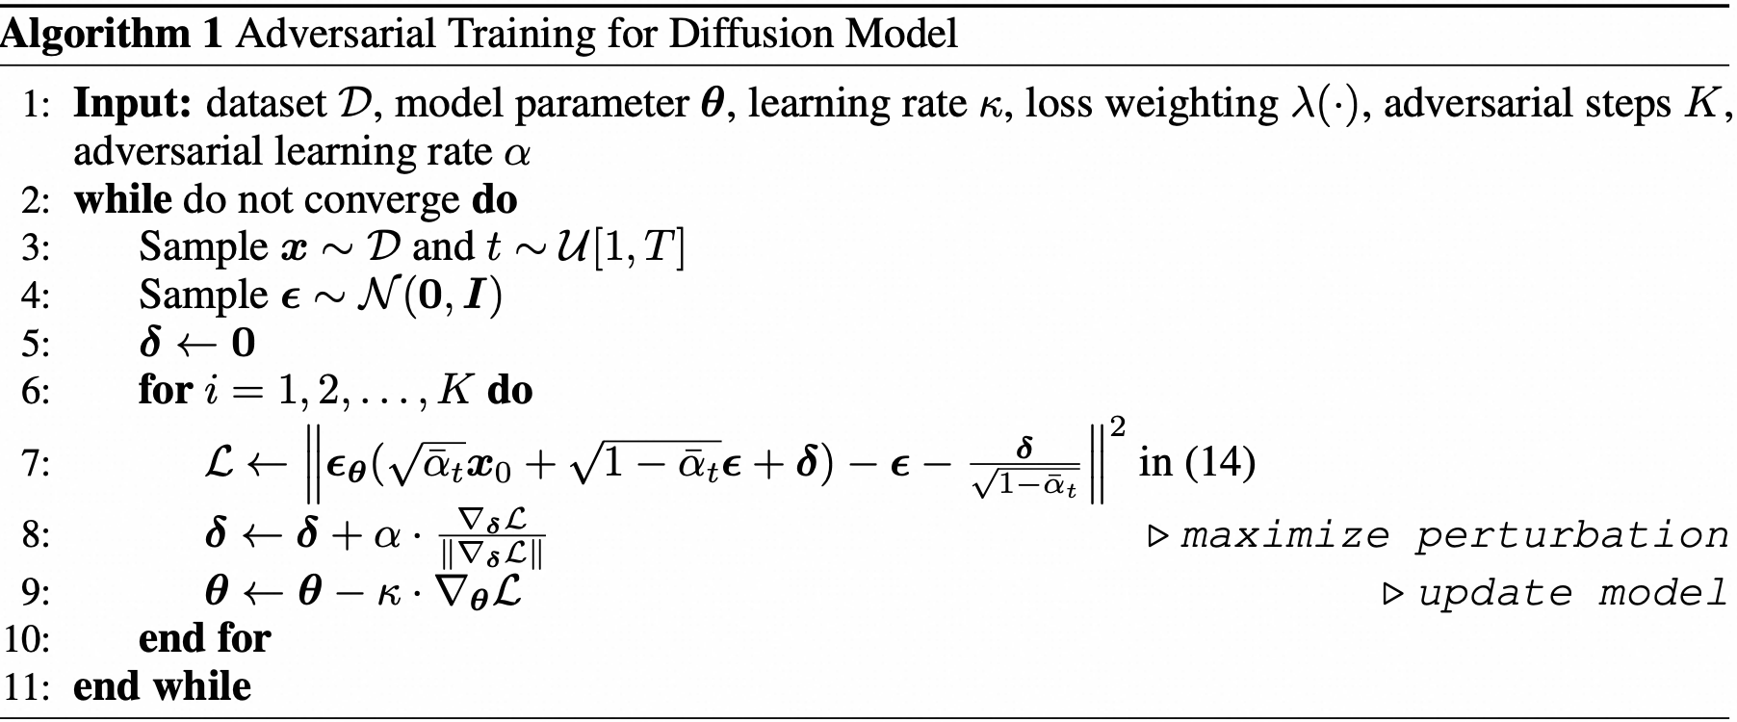
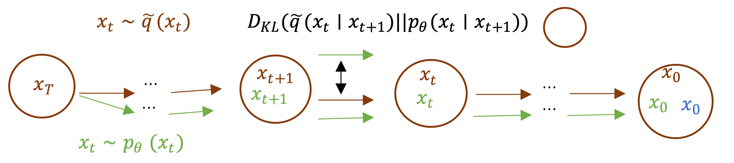
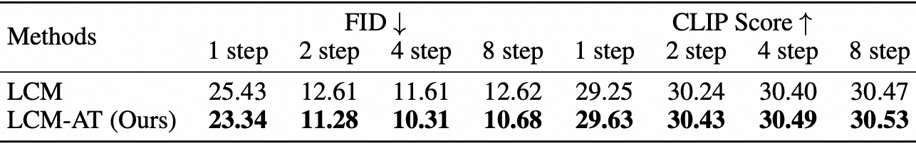
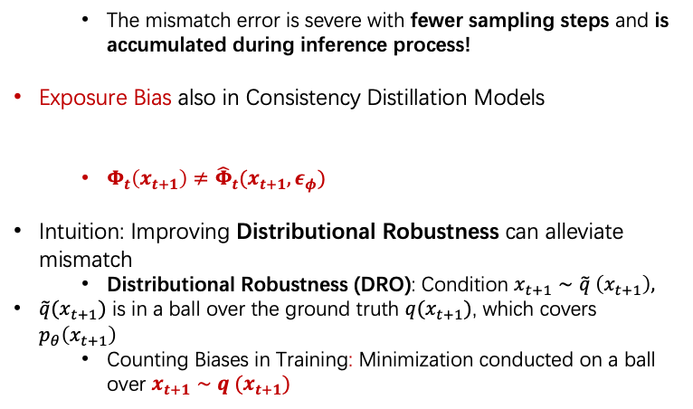
Improved Diffusion-based Generative Model with Better Adversarial Robustness
Zekun Wang, Mingyang Yi, Shuchen Xue, Zhenguo Li, Ming Liu, Bing Qin, Zhi-Ming Ma
Motivation: Distribution Mismatch in Diffusion-based Models
Method
Experiment on Diffusion Models
Objectives:
Diffusion Models
Consistency Distillation
Results on CIFAR-10 32x32
Exposure Bias: Mismatch in training and inference:
vs
Training: condition $x_{t+1}∼q\left(x_{t+1}\right)$ Inference: condition${ x}_{t+1}∼p_{θ}(x_{t+1})$
Efficient Implementation
Fine-tuning Models with Free AT!
Results on ImageNet 64x64
The mismatch error is severe with fewer sampling steps and is accumulated during inference process!
Exposure Bias also in Consistency Distillation Models
$Φ_{t}\left(x_{t+1}\right)≠{\hat{Φ}}_{t}(x_{t+1},ε_{φ})$
Intuition: Improving Distributional Robustness can alleviate mismatch
Distributional Robustness (DRO): Condition $x_{t+1}∼\tilde{q} \left(x_{t+1}\right),$
$\tilde{q}(x_{t+1})$ is in a ball over the ground truth $q(x_{t+1})$, which covers $p_{θ}\left(x_{t+1}\right)$
Counting Biases in Training: Minimization conducted on a ball over $x_{t+1}∼q (x_{t+1})$
Visualization
Baseline
Ours
A photo of beautiful mountain with realistic sunset and blue lake, highly detailed, masterpiece
Experiment on Consistency Models
Results of LCM on MS-COCO 2014 at 512x512
Astronaut in a jungle, cold color palette, muted colors, detailed, 8k.

